Slide 1
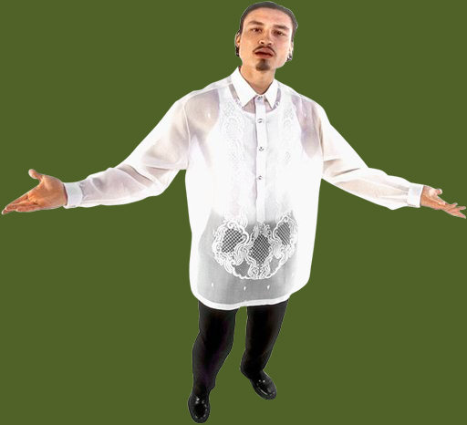
Capitalization
Or should that letter remain lower case?
Do I need a capital letter?
A
a

Slide 2
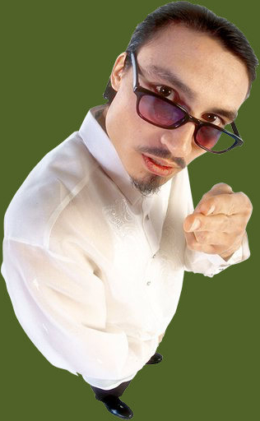
This presentation covers capitalizing the first letter of the first word of a sentence, the pronoun I , and proper nouns.

Slide 3
A capitalization item on an objective test might look like this . . .

Slide 4
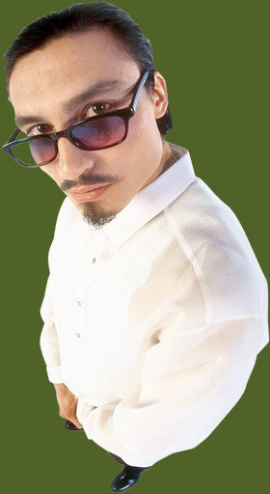
Sample Item
Wanda wouldn’t offer her little brother a
Christmas cookie because he ate all of her
Halloween candy last october.
Brother
Cookie
October
No change is necessary.
Wanda wouldn’t offer her little brother a
A
Christmas cookie because he ate all of her
B
Halloween candy last october.
C
Brother
Cookie
October
No change is necessary.
Wanda wouldn’t offer her little brother a
A
Christmas cookie because he ate all of her
B
Halloween candy last October.
C
Brother
Cookie
October
No change is necessary.
Is brother, cookie, or october a problem?
October needs a capital letter, which option C provides.

Slide 5
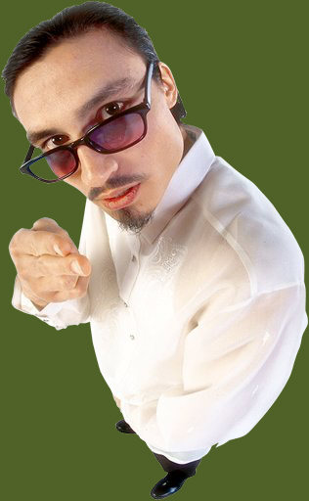
Capitalize the first letter of the first word of a sentence.
the rotten pear sat in a puddle of goo on the kitchen counter.
The rotten pear sat in a puddle of goo on the kitchen counter.
Dude, formal writing is not the same as texting your friend!

Slide 6
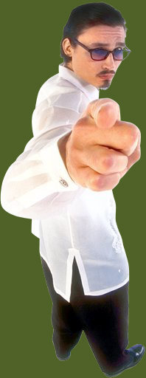
Capitalize the pronoun I.
If that liar Darlene claims that she spent the night studying, i will say that i saw her kissing Thomas at the movies.
If that liar Darlene claims that she spent the night studying, I will say that I saw her kissing Thomas at the movies.
Don’t be lazy! Capitalize those I ’s. You deserve a capital letter!

Slide 7
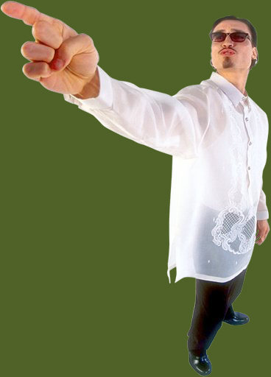
Capitalize proper nouns.
On tuesday, september 18, elizabeth cooked her first pot of squid eyeball stew.
On Tuesday, September 18, Elizabeth cooked her first pot of squid eyeball stew.
Proper nouns include the days of the week, the months of the year, and names.

Slide 8
Titles Before Names
Professor Stone
Uncle Jerry
President Obama
the nursing professor
my uncle
the president of our stamp collecting club
Capitalize these!
But use lower case for these!

Slide 9
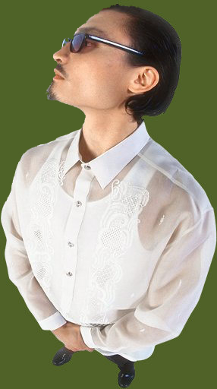
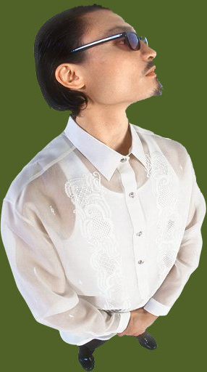
Specific Places
Tito’s Taco Palace
New York City
Gatorland
the taco stand outside
a city
a theme park
Capitalize these!
But use lower case for these!

Slide 10
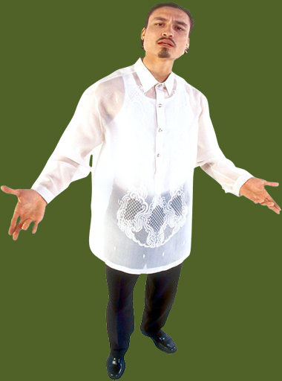
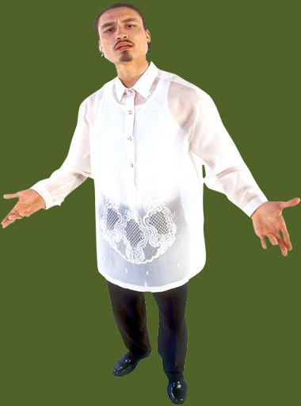
Organizations
World Wildlife Fund
American Red Cross
Doctors Without Borders
an environmental group
an emergency response agency
a medical humanitarian organization
But use lower case for these!
Capitalize these!

Slide 11
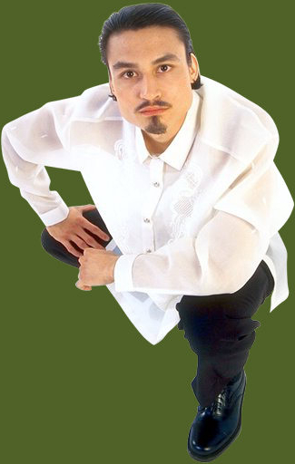
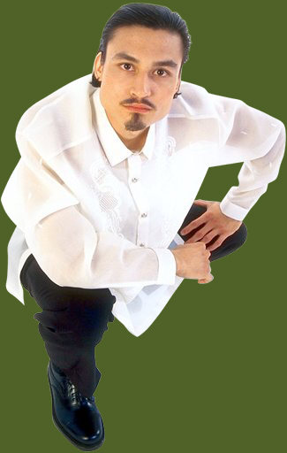
Companies
Starbucks Corporation
The Coca-Cola Company
Apple Inc.
a coffee house
a soda supplier
a computer manufacturer
But use lower case for these!
Capitalize these!

Slide 12
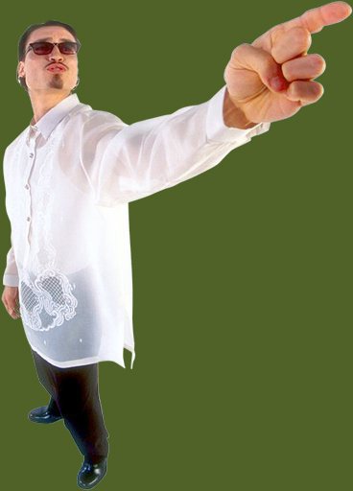
Product Names
Frappuccino
Oreo
Power Mac
a frozen coffee
a cookie
a computer
Capitalize these!
But use lower case for these!

Slide 13
Religions
Buddhism
Seventh Day Adventists
Druids
meditation practice
vegetarians
nature worshippers
Capitalize these!
But use lower case for these!

Slide 14
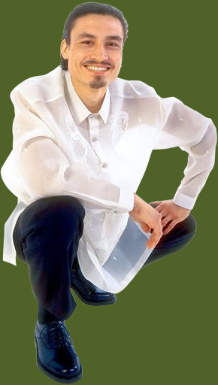
Languages
Polish
Russian
Spanish
Capitalize these!

Slide 15
Nationalities
Brazilians
the French
ancient Egyptians
American
Capitalize these!

Slide 16
Holidays
Thanksgiving
Halloween
Fourth of July
family dinner
costume party
fireworks show
Capitalize these!
But use lower case for these!

Slide 17
Departments
Division of Motor Vehicles
Orlando Fire Department
Internal Revenue Service
driver’s license
firefighters
tax collectors
But use lower case for these!
Capitalize these!

Slide 18
Historical Eras
Late Cretaceous
Old Kingdom
the Great Depression
when dinosaurs lived
proliferation of pyramids
poor economic times
Capitalize these!
But use lower case for these!
Notes:
Late Cretaceous = when dinosaurs became extinct

Slide 19
Regions of the Country
the South
the Northeast
the West
the south exit
blowing from the northeast
west of the mall
Capitalize these!
But use lower case for these!

Slide 20
Course Names
Fundamentals of Biology
Intermediate Algebra
Honors Literature
biology
algebra
literature
But use lower case for these!
Capitalize these!

Slide 21
Titles of Works
Moby-Dick
Aliens
Thriller
a thick novel
the best movie ever made
a dance album
Capitalize these!
But use lower case for these!

Slide 22
Quick Test
Directions: In the items that follow, choose the option that corrects an error in the underlined portion(s). If no error exists, choose “No change is necessary.”
Show me what you know.

Slide 23
Item 1
Jeffrey thought he would hate humanities, but
once Professor Kimble reached the Italian
renaissance, the beautiful marble nudes got
Jeffrey’s attention.
Humanities
professor
Renaissance
No change is necessary.
Jeffrey thought he would hate humanities, but
A
once Professor Kimble reached the Italian
B
renaissance, the beautiful marble nudes got
C
Jeffrey’s attention.
Humanities
professor
Renaissance
No change is necessary.
Jeffrey thought he would hate humanities, but
A
once Professor Kimble reached the Italian
B
Renaissance, the beautiful marble nudes got
C
Jeffrey’s attention.
Humanities
professor
Renaissance
No change is necessary.

Slide 24
Item 2
Janelle will take Fundamentals of Biology next
semester; she hates Science classes but needs the
credits to transfer to a university.
fundamentals of biology
science
University
No change is necessary.
Janelle will take Fundamentals of Biology next
A
semester; she hates Science classes but needs the
B
credits to transfer to a university.
C
fundamentals of biology
science
University
No change is necessary.
Janelle will take Fundamentals of Biology next
A
semester; she hates Science classes but needs the
B
credits to transfer to a university.
C
fundamentals of biology
science
University
No change is necessary.

Slide 25
Item 3
My family prefers to cook a ham on holidays, but
uncle Bart is a vegetarian, so my mother prepares
“tofurkey” for him.
Holidays
Uncle
Vegetarian
No change is necessary.
My family prefers to cook a ham on holidays, but
A
uncle Bart is a vegetarian, so my mother prepares
B C
“tofurkey” for him.
Holidays
Uncle
Vegetarian
No change is necessary.
My family prefers to cook a ham on holidays, but
A
uncle Bart is a vegetarian, so my mother prepares
B C
“tofurkey” for him.
Holidays
Uncle
Vegetarian
No change is necessary.

Slide 26
Item 4
Dai is vietnamese, but she grew up in Puerto
Rico, where she attended cooking school; now she is the head chef at the Cuban restaurant on
Orange Avenue.
Vietnamese
Cooking School
cuban
No change is necessary.
Dai is vietnamese, but she grew up in Puerto A
Rico, where she attended cooking school; now B she is the head chef at the Cuban restaurant on
C
Orange Avenue.
Vietnamese
Cooking School
cuban
No change is necessary.
Dai is vietnamese, but she grew up in Puerto A
Rico, where she attended cooking school; now B she is the head chef at the Cuban restaurant on
C
Orange Avenue.
Vietnamese
Cooking School
cuban
No change is necessary.

Slide 27
Item 5
Turn left! We need to go west on Highway 50;
otherwise, we will be heading toward
Daytona beach.
West
highway 50
Daytona Beach
No change is necessary.
Turn left! We need to go west on Highway 50;
A B
otherwise, we will be heading toward
Daytona beach.
C
West
highway 50
Daytona Beach
No change is necessary.
Turn left! We need to go west on Highway 50;
A B
otherwise, we will be heading toward
daytona beach.
C
West
highway 50
Daytona Beach
No change is necessary.

Slide 28
Item 6
Katelyn used her last dollar to buy m&m candies;
she would have enjoyed a Pepsi to wash them
down but the cafeteria prices were too expensive.
M&M
pepsi
Cafeteria
No change is necessary.
Katelyn used her last dollar to buy m&m candies;
A
she would have enjoyed a Pepsi to wash them
B
down but the cafeteria prices were too expensive.
C
M&M
pepsi
Cafeteria
No change is necessary.
Katelyn used her last dollar to buy m&m candies;
A
she would have enjoyed a Pepsi to wash them
B
down but the cafeteria prices were too expensive.
C
M&M
pepsi
Cafeteria
No change is necessary.

Slide 29
Item 7
Juan is taking a religion class this semester; he
likes the professor and the readings, but he most
enjoys the intoxicating perfume that Isabella, his
tablemate, wears.
Religion
Professor
Perfume
No change is necessary.
Juan is taking a religion class this semester; he
A
likes the professor and the readings, but he most
B
enjoys the intoxicating perfume that Isabella, his
C
tablemate, wears.
Religion
Professor
Perfume
No change is necessary.
Juan is taking a religion class this semester; he
A
likes the professor, but he most enjoys the
B
perfume that Isabella, his tablemate, wears.
C
Religion
Professor
Perfume
No change is necessary.

Slide 30
Item 8
Patrick visited the police station to see if someone
had found Squeeze, his 9-foot albino python, but
officer Rodriguez said that no reptiles had been
recently caught.
Police Station
Python
Officer
No change is necessary.
Patrick visited the police station to see if someone
A
had found Squeeze, his 9-foot albino python, but
B
officer Rodriguez said that no reptiles had been
C
recently caught.
Police Station
Python
Officer
No change is necessary.
Patrick visited the police station to see if someone
A
had found Squeeze, his 9-foot python, but
B
officer Rodriguez said that no reptiles had been
C
recently caught.
Police Station
Python
Officer
No change is necessary.

Slide 31
Item 9
Byron likes spicy foods, so he chose the Asian
chicken wrap. Martha prefers bland dishes and
ordered a large basket of french fries.
asian
Large
French
No change is necessary.
Byron likes spicy foods, so he chose the Asian
A
chicken wrap. Martha prefers bland dishes and
ordered a large basket of french fries.
B C
asian
Large
French
No change is necessary.
Byron likes spicy foods, so he chose the Asian
A
chicken wrap. Martha prefers bland dishes and
ordered a large basket of french fries.
B C
asian
Large
French
No change is necessary.

Slide 32
Item 10
Niki is a practicing hindu, so she was offended
when Sean pulled into a McDonald’s drive-thru
to order a Big Mac.
Hindu
mcdonald’s
big mac
No change is necessary.
Niki is a practicing hindu, so she was offended
A
when Sean pulled into a McDonald’s drive-thru
B
to order a Big Mac.
C
Hindu
mcdonald’s
big mac
No change is necessary.
Niki is a practicing hindu, so she was offended
A
when Sean pulled into a McDonald’s drive-thru
B
to order a Big Mac.
C
Hindu
mcdonald’s
big mac
No change is necessary.

Slide 33
the end.
The end.
The End.
Better.

